Slide 1

Ilonka Walker
Notes:
Thank you to the UN NGO – committee of Aging for inviting me to present today and I want to give a special thanks Magda who is one of our UN representatives and a Generations United fellow thank you for your service and your commitment to GU.

Slide 2
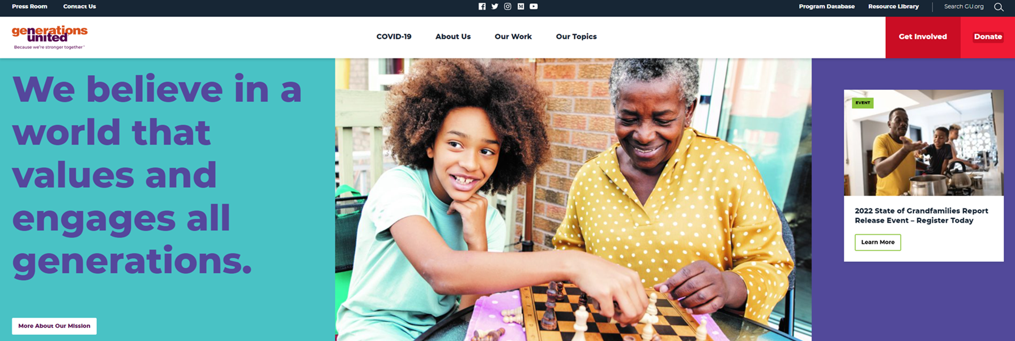
Mission
The mission of Generations United is to improve the lives of children, youth, and older people through intergenerational collaboration, public policies, and programs for the enduring benefit of all.
Notes:
Generations United is a nonprofit organization that was created with a mission in mind to help improve the lives of children, youth, and older adults through intergenerational collaboration, public policies, and programs. We work to strengthen practices and polices that benefit all generations. Generations United push collaboration among all generations, for that unique energy and productivity that happens when people of all ages come together

Slide 3
Key areas of our work
High-quality intergenerational programs
Grandfamilies
Shared spaces and Places
“We formed Generations United to argue for a caring society.”
- Jack Ossofsky
Notes:
I love this quote Jack Ossofsky, one of our co-founders and the former executive director of the National Council On Aging. That helps to perfectly sum up our work as we are doing our part to create a more caring society.
We have two separate teams working on our grandfamilies work: National Center on Grandfamilies and Grandfamilies & Kinship Support Network: A National Technical Assistance Center
And of course, shared spaces and places what we are here to talk about today!

Slide 4
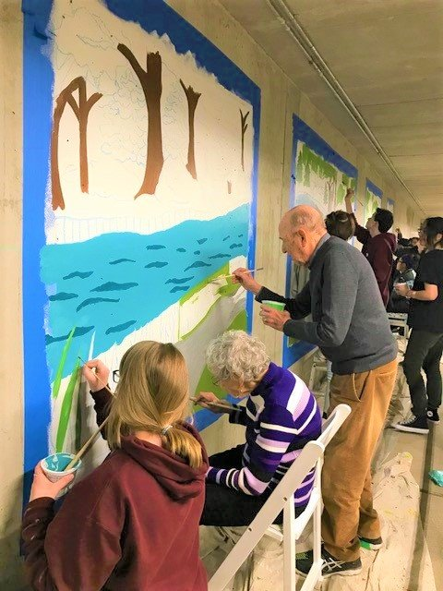
Intergenerational Housing Types
Affordable, market-rate and supportive housing
University-based retirement communities
Intergenerational communities
Intergenerational shared sites
Kinship/Grandfamilies housing
Homesharing
Co-housing
Naturally occurring multi-generational housing
Notes:
Intergenerational Housing is housing combines people by age and offers design features and/or programming that brings people together to maximize social interaction and promote mutual support.
There are several types of intergenerational Housing Types including:
Affordable, market rate, and supportive housing for - affordable housing for low- and moderate-income families, provided social services or transitional housing. example one flushing in New York
University-based retirement communities –University-based retirement communities provide on-site classes, wellness programs, and art activities to help seniors stay mentally active. Purchase broadview college -
Intergenerational communities -
Intergenerational shared sites- intentionally designed places that provide services/programs to multiple generations simultaneously and foster meaningful cross-age relationships. - one generation
Kinship/grandfamilies housing- bridge meadows Grandfamiles are when other relatives like grandparents or aunts or uncles are raising their grandchildren.
Homesharing- Example of home-sharing- NYU Ernest Gonzales. Where adults age become intergenerational home-share hosts. The program makes intergenerational home-share matches between adults with a spare room and a NYU graduate students.
Co-housing- is an intentional, collaborative neighborhood that combines private homes with shared indoor and outdoor spaces designed to support an active and interdependent community life.
Naturally occurring multi-generational housing – like your own neighborhood or moving your parents into your home while raising your children which has been on the rise

Slide 5
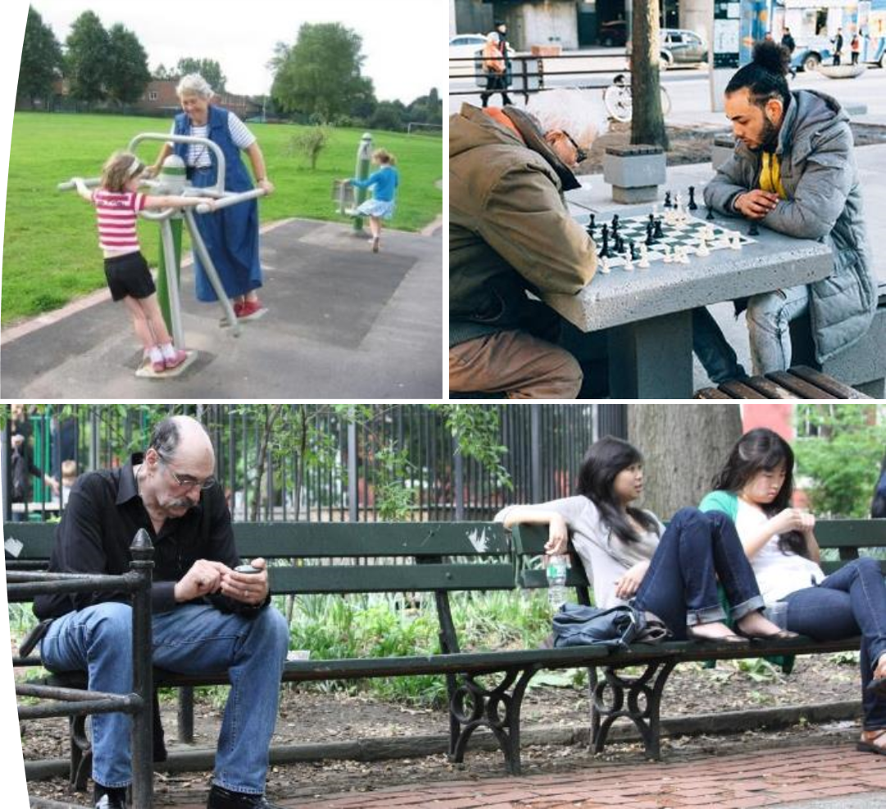

Intergenerational
Multigenerational
Notes:
These pictures help to illustrate the difference between multigenerational and intergenerational spaces. It’s the integration and mingling that makes it intergenerational. Most things in are community can be used by multiple generations, but do they help to create an environment where multiple generations can interact with one another.

Slide 6
A Park as a Multigenerational Setting
Matt Kaplan, Ph.D., Professor, Intergenerational Programs and Aging, Penn State University https://aese.psu.edu/outreach/intergenerational
Notes:
For example, here you see there is a park that multiple generations are using but the generations aren’t interacting with one another and there is no intentionality in the design that creates an environment

Slide 7
A Park as an Intergenerational Setting
Matt Kaplan, Ph.D., Professor, Intergenerational Programs and Aging, Penn State University https://aese.psu.edu/outreach/intergenerational
Notes:
Versus this park, you see here where it was designed intentional with the idea of creating space and community where multiple generations can interact and share activities.

Slide 8
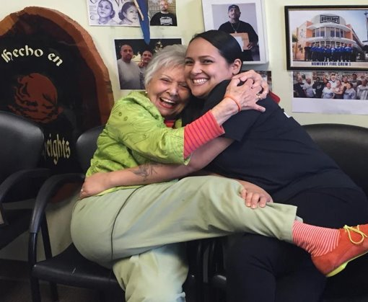
Intentional

Slide 9
Who Benefits from Intergenerational Programs?
Everyone.
Notes:
Intergenerational programs in communities bring people of different ages together in purposeful, mutually beneficial activities that promote greater understanding and respect between generations.

Slide 10
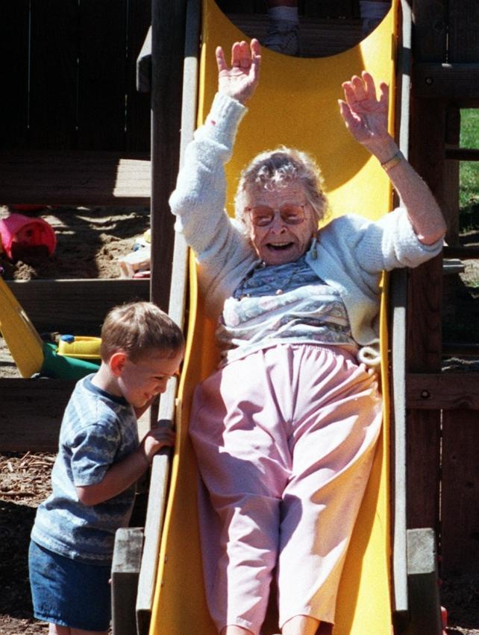
Benefits
Reduce age-segregation & ageism
Improve health, mental health, well-being & self-esteem
Decrease social isolation, depression & loneliness
Create additional supports for aging in place
Notes:
This photo was provided to us during our intergenerational photo contest.

Slide 11


Benefits
Create a vehicle to bring generations together
Improve community infrastructure & facilities (e.g. gathering spaces, parks, gardens, theatre, art) while saving dollars
Increase social, recreational, & volunteer opportunities that build a sense of community

Slide 12
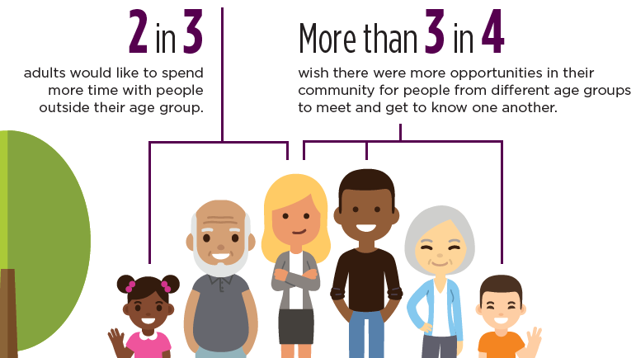
Notes:
We completed a report in partnership with The Eisner Foundation that includes the few findings from national surveys, Creating Places Where Young And Old Thrive And I just wanted to share a few of those finding with you today.

Slide 14
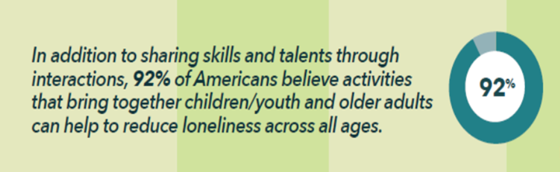
Notes:
It’s what people want!

Slide 15
Notes:
A record number of Americans live in multigenerational households today.

Slide 16

Next steps
We are in the process of creating an Intergenerational Housing Blueprint that is expected to be released in June.
The blueprint will address
The critical need
Housing Models
Recommendations
Action Steps and Strategies
Notes:
Recommendations
Research
Practice
Communications
Policy
Financing

Slide 17

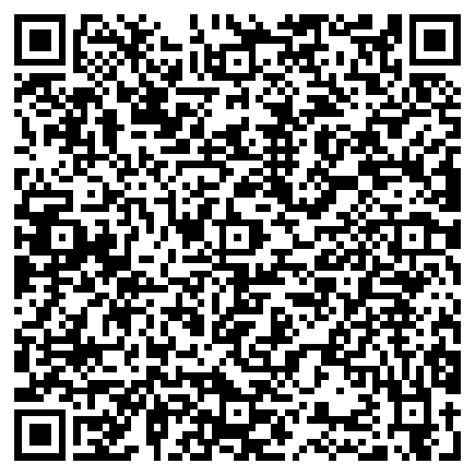

Stay Connected
Sign up for Generations This Week
Connect via social media
  Twitter @GensUnited
  Instagram @GensUnited
  Facebook @GenerationsUnited
  LinkedIn
Notes:
If you are interested in staying connected with us, please scan the QR code and connect with us on social media.

Slide 18

Thank you!
For more information:
Contact: iwalker@gu.org
Generations United www.gu.org
Notes:
Here is my contact information. Thank you again

